Slide 1


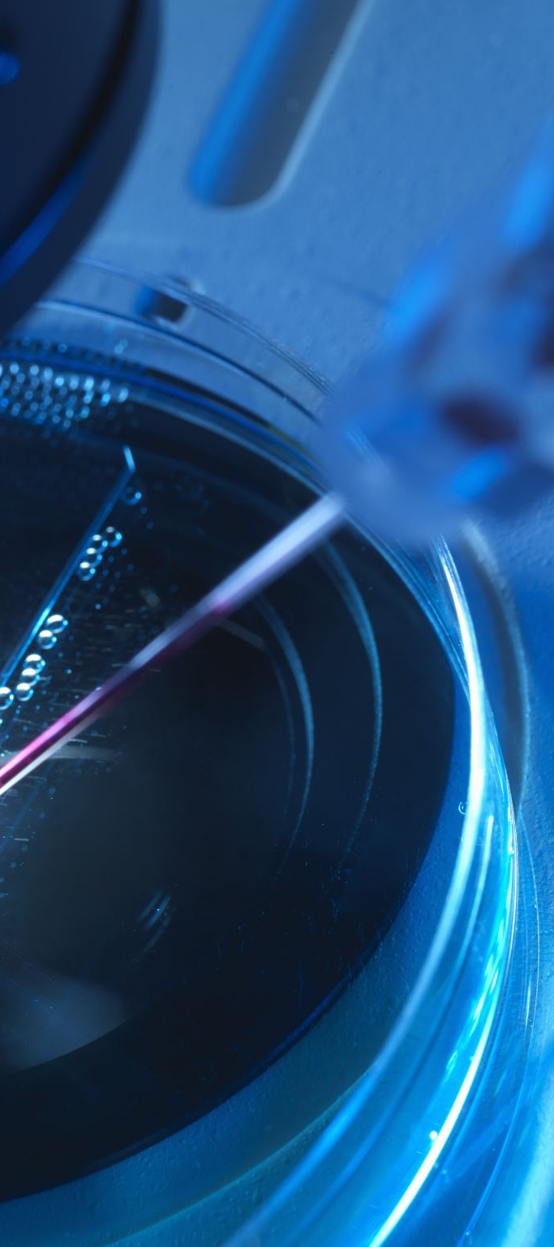

CAPSTONE PROJECT
SQL AND TABLEAU
z

Slide 2
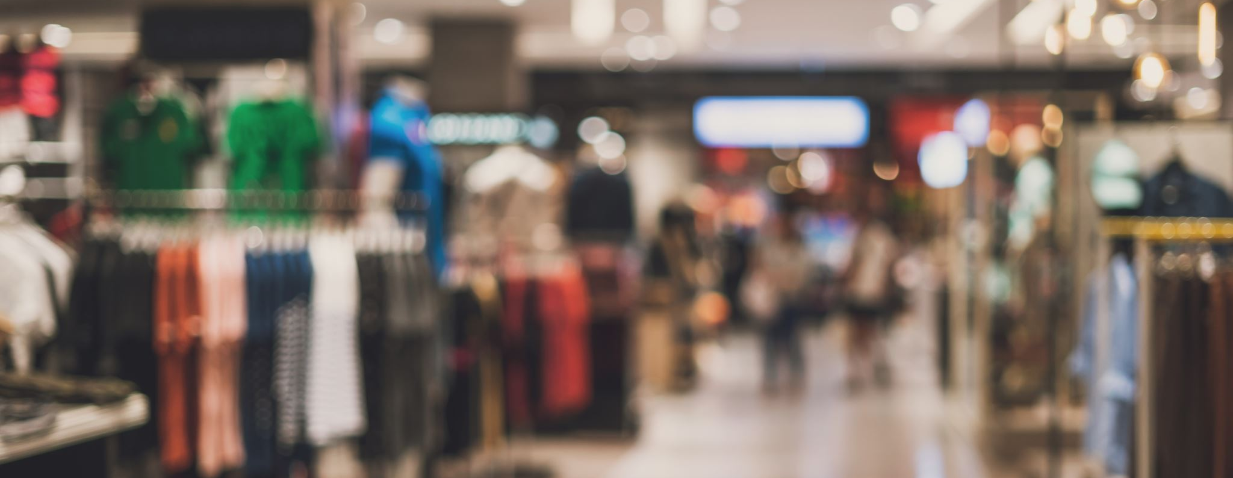
This project is about online retail.
Online retail is the selling of merchandise in small quantities to the general public over the Internet.
Online retail is part or a subset of e-commerce, meaning that 100% of online retailers can say that they are an e-commerce business, but an e-commerce business doesn’t necessarily do online retail. but not all e-commerce is online retailing.
z
INTRODUCTION

Slide 3
UNIT PRICE: THE PRODUCT PRICE PER UNIT
PRODUCT NAME:
ALSO KNOWN AS THE PRODUCT (ITEM) NAME OF EACH PRODUCT
ORDER DATE: THE DATE EACH TRANSACTION WAS GENERATED.
INVOICE NO:
A 6-DIGIT INTEGRAL NUMBER UNIQUELY ASSIGNED TO EACH TRANSACTION. IF THIS CODE STARTS WITH THE LETTER ‘C’, IT INDICATES A CANCELLATION.
ORDER NUMBER:
A SIX DIGIT UNIQUE IDENTIFICATION OF EACH ORDER.
QUANTITY:
THE QUANTITIES OF EACH PRODUCT (ITEM) PER TRANSACTION.
DESCRIPTION OF COLUMN HEADERS
z

Slide 4

QUESTIONS
AND SCREENSHOTTED
RESULTS
STRUCTURED QUERY LANGUAGE (SQL)
PROJECT
z

Slide 5
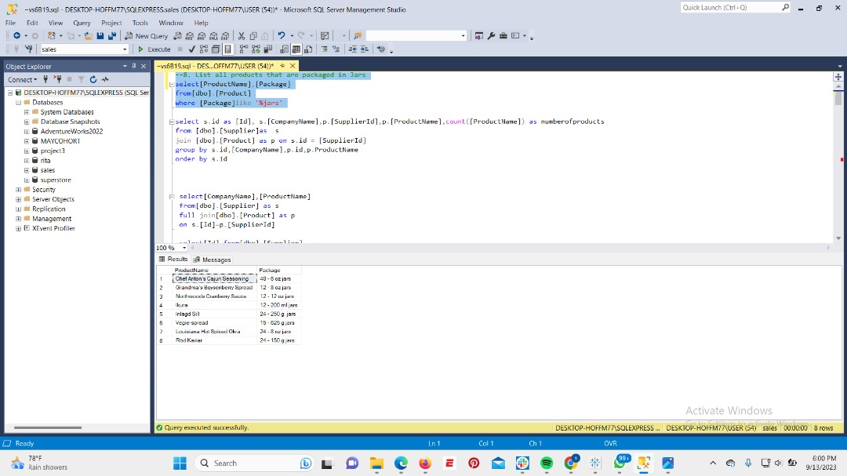

Slide 6
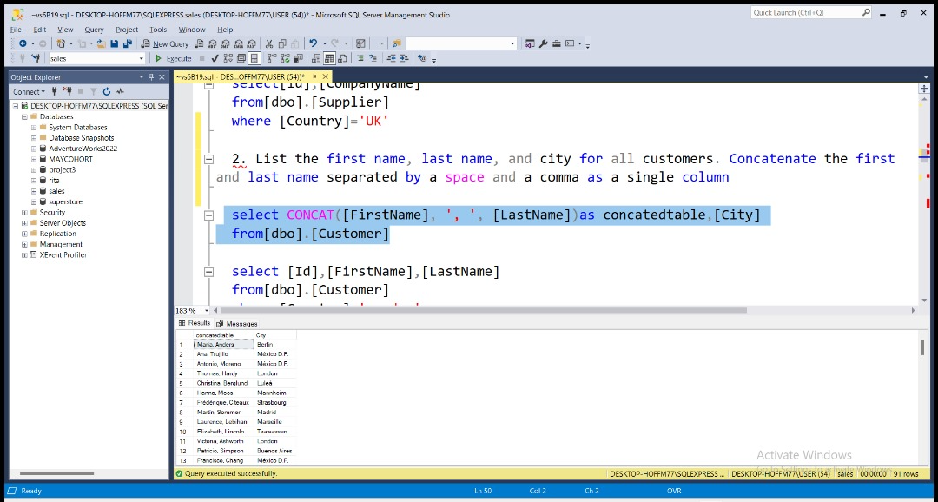

Slide 7
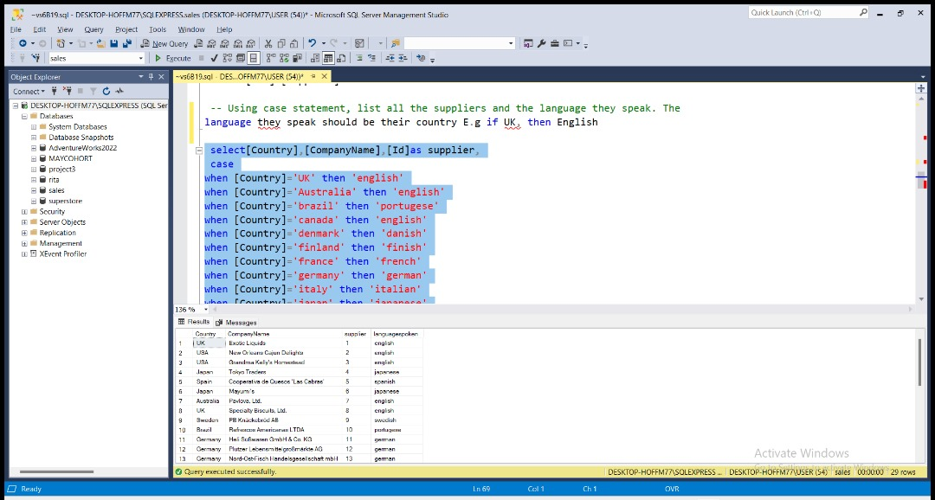

Slide 8
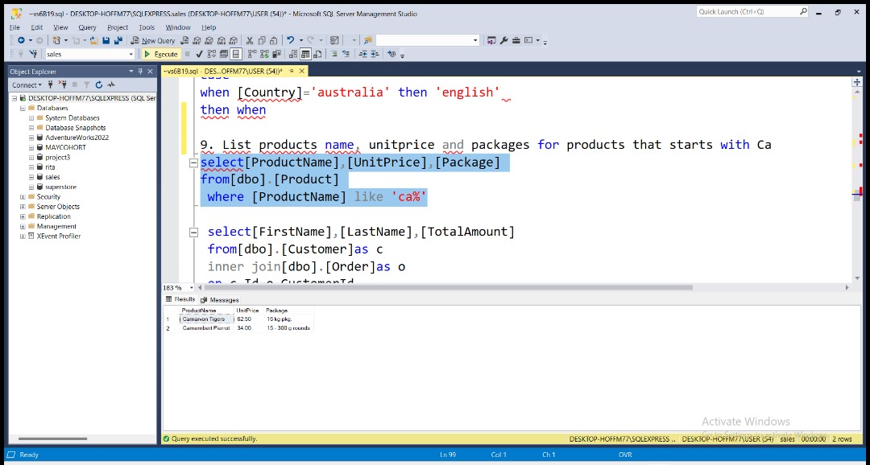

Slide 9
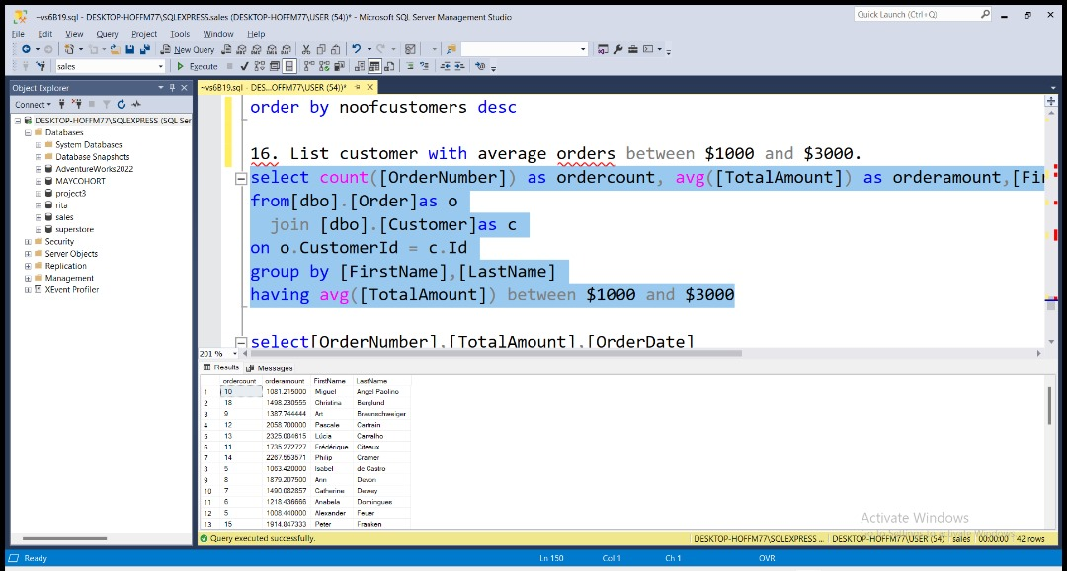

Slide 10
QUESTIONS
AND SCREENSHOTTED RESULTS
VISUALIZATION WITH TABLEAU

Slide 11
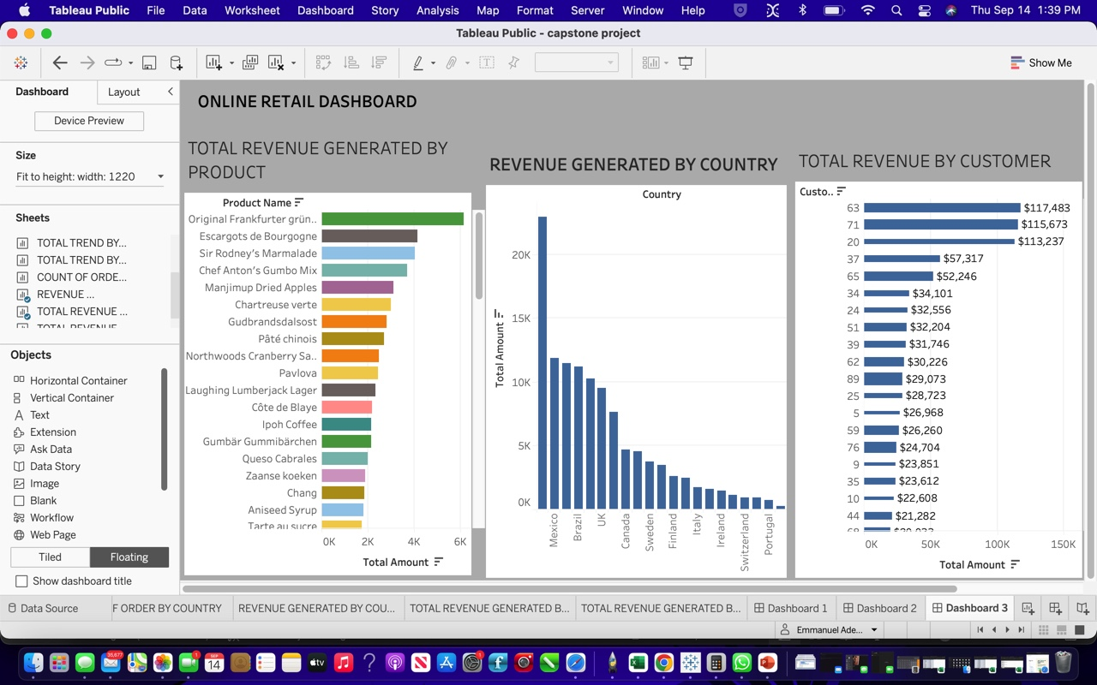
DASHBOARD WITH FOCUS ON PRODUCT
z

Slide 12
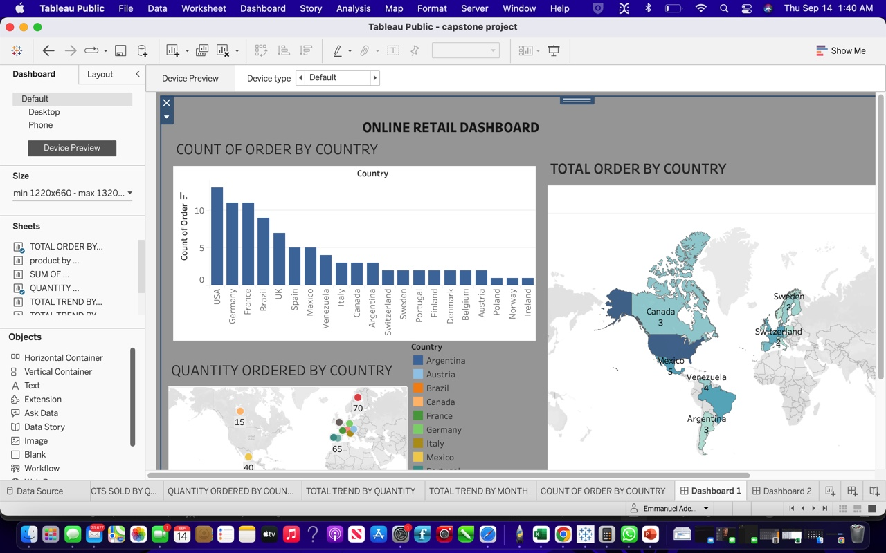
DASHBOARD WITH FOCUS ON COUNTRY
z

Slide 13
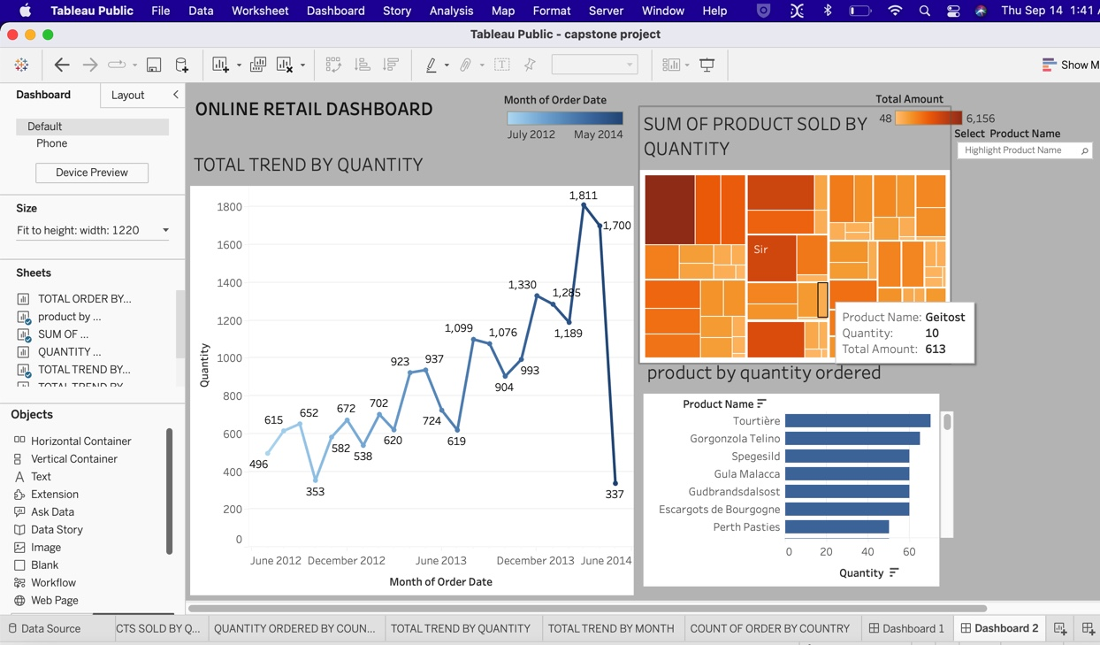
DASHBOARD WITH FOCUS ON PRODUCT
z

Slide 14
RECOMMENDATIONS AND INSIGHT
The USA generated the highest followed by Mexico and Canada
Customer ID 63 generated the highest revenue seconded by customer ID 71.
Product original Frankfurter grune sobe generated the highest revenue followed by Escargots de Bourgonone then Sir Rodney’s Marmalade.
Product Tourtiere had more quantity ordered but did not generate as much revenue as Original Frankfurter grune sobe.
Despite the USA having the highest count of order (13) and France having the count of order of (11) France had more quantity ordered of (93)
Norway generated the least revenue.
Since the country that generated the highest revenue was USA and Mexico more products should be deployed to these countries.
Since products like original frankfurter grune sobe, Escargots de Bourgonone and Sir Rodney’s Marmalade generated more revenue. Hence, more of this products should be bought.
Incentives should be given to Customers that generate more revenue to encourage them.
More advert and product enlightenment should be focused on in Norway.
More awareness should be given to customers about products with less revenues

Slide 15

THANK YOU
z

